Slide 1

What Is
Cybersecurity?
Notes:
Thank you Will.
Today I’m going to cover a few foundational areas regarding cybersecurity.
We’ll discuss the “why’s” of cybersecurity and its importance.
We’ll then talk about the sectors that are challenged by today’s cybersecurity issues.
Finally, we’ll take a look at a few of the organizations and documents that help support organizational activities when
confronted with cybersecurity challenges.
So, let’s begin!

Slide 2
WHAT IS CYBERSECURITY?
It is the practice of protecting data
against unwanted access.
Prevents unwanted access to your information in both personal and business use
Helps keep your files and data secure and private
Major job growth industry over the next several years
Rapidly evolving ROLES
Notes:
Because the Internet is still very much a wild west when it comes to security, cybersecurity is needed by all those that go online for personal, business, or other reasons.
Therefore, the all important question is for everyone is, “What is cybersecurity?”.
A working definition of cybersecurity is, “the practice of protecting computers and their networks against unwanted access and the loss of data or theft.
Four main points that are relevant to this definition of cybersecurity are:
The prevention of unwanted access to your information either personal use or business use or potentially both.
By thinking in a “cybersecurity” mentality mode, users should keep their files and data secure and private when online
For those interested in the cybersecurity sector, hopefully all of you, major job growth is projected over the next several years which should be very enticing for starting a cybersecurity career!
Cybersecurity is continually evolving as an industry so tomorrow may look different from today due to new threats, viruses, attacks, digital forensics tools, etc.

Slide 3

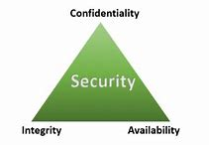
CyberSecurity CIA Triad
Confidentiality - Measures designed to prevent sensitive information from unauthorized access attempts.
Integrity - Protecting data from deletion or modification from any unauthorized party.
Availability - Means information should be consistently and readily accessible for authorized parties.
‹#›
Notes:
Let’s now discuss the CyberSecurity CIA Triad.
When first hearing the acronym CIA, I’m sure some of you may have thought CIA stood for Central Intelligence Agency.
However, in this program and context CIA stands for Confidentiality, Integrity, and Availability.
A triad is a group of three connected things, hence the three points for the green pyramid that you see.
These three points on the triangle comprise the CIA’s security philosophy which are:
The top point is confidentiality which is the protection through defining and enforcing access levels of information
An example is the separation of sensitive information from necessary accessible information.
The second point is integrity which is designed to protect data from deletion or modification from anyone who is unauthorized to do so.
The second component of integrity is that if a change does occur that the change is reversible so that the integrity of the data is in intact.
An Example is a PDF is readable by all but only modifyable by the author of the document.
The third point is availability which refers to the availability of the data.
Essentially, this component requires authentication mechanisms, access channels and systems to work properly so that information is protected and ensured.
An example is the high availability in that, data is redundantly accessible if even a system crashes, hardware fails, or even if a power outage occurs.

Slide 4





CHALLENGES OF CYBERSECURITY?
Technology is always evolving
Can be expensive
You have no idea when its coming until you figure out its happening or it's already over
Not enough people to fill the jobs
(estimated 3.5 million jobs)
Notes:
At the moment, there are five challenges for cybersecurity:
First, technology is always evolving
Practically every day there’s a new technology created or new app, or new website becoming available attempting to make things faster, cheaper, and more simple.
Example: banking apps are now coming out with free checking and not from the typical banks like Chase or Bank of America. Coinbase now offers direct deposit of funds to your coinbase account converted to cryptocurrency fee free.
Another challenge is that we have no idea when a technology coming or when it’s happening or if it’s over
Again, we’re in the midst of a def or decentralized financei revolution with Blockchain technology that offers bitcoin, ethereum, and the other cryptocurrencies
Never 100% secure
Because a technology is created by a human, nothing is 100% safe. Humans are viewed as the weakest link in the technology chain.
Another challenge is that not enough people to fill jobs (estimated 3.5 million jobs)
(Show tab) Using Cyberseek.org, you can view the number job openings at the national and state levels.
And lastly, cybersecurity can be very expensive
Recruiting, hiring, training, hardware, software, legal fees, all of these things add up to be major expenses for organizations today!

Slide 5



EMERGING TECHNOLOGIES
DEVICES CONNECTED TO THE INTERNET - GIVING ACCESS TO THE NETWORK
IOT - Internet of Things - Devices that are controlled from an app/Bluetooth or SmartThings
AI - Artificial Intelligence - wide-ranging branch of computer science concerned with building smart machines capable of performing tasks that typically require human intelligence
Cloud computing - the on-demand availability of computer system resources, especially data storage and computing power, without direct active management by the user. The term is generally used to describe data centers available to many users over the Internet
Notes:
Let’s now briefly touch upon a few new technologies.
First, IOT or the internet of things is the connection of a device to the Internet.
Examples: Kitchen appliances like a Toaster, smart watches, Ev cars, etc.all are examples of IOT
Artificial Intelligence or AI which is where machines are programmed with special programming code to “think” and perform tasks typically performed by humans.
Example: Chatbots, all types of robots, and again self driving vehicles
Cloud computing is the replacement of physical hardware with software and virtualization warehoused in data centers throughout the world.
Example: Oracle Cloud Infrastructure, Amazon Web Services, Google Cloud Platform, and Microsoft Azure

Slide 6
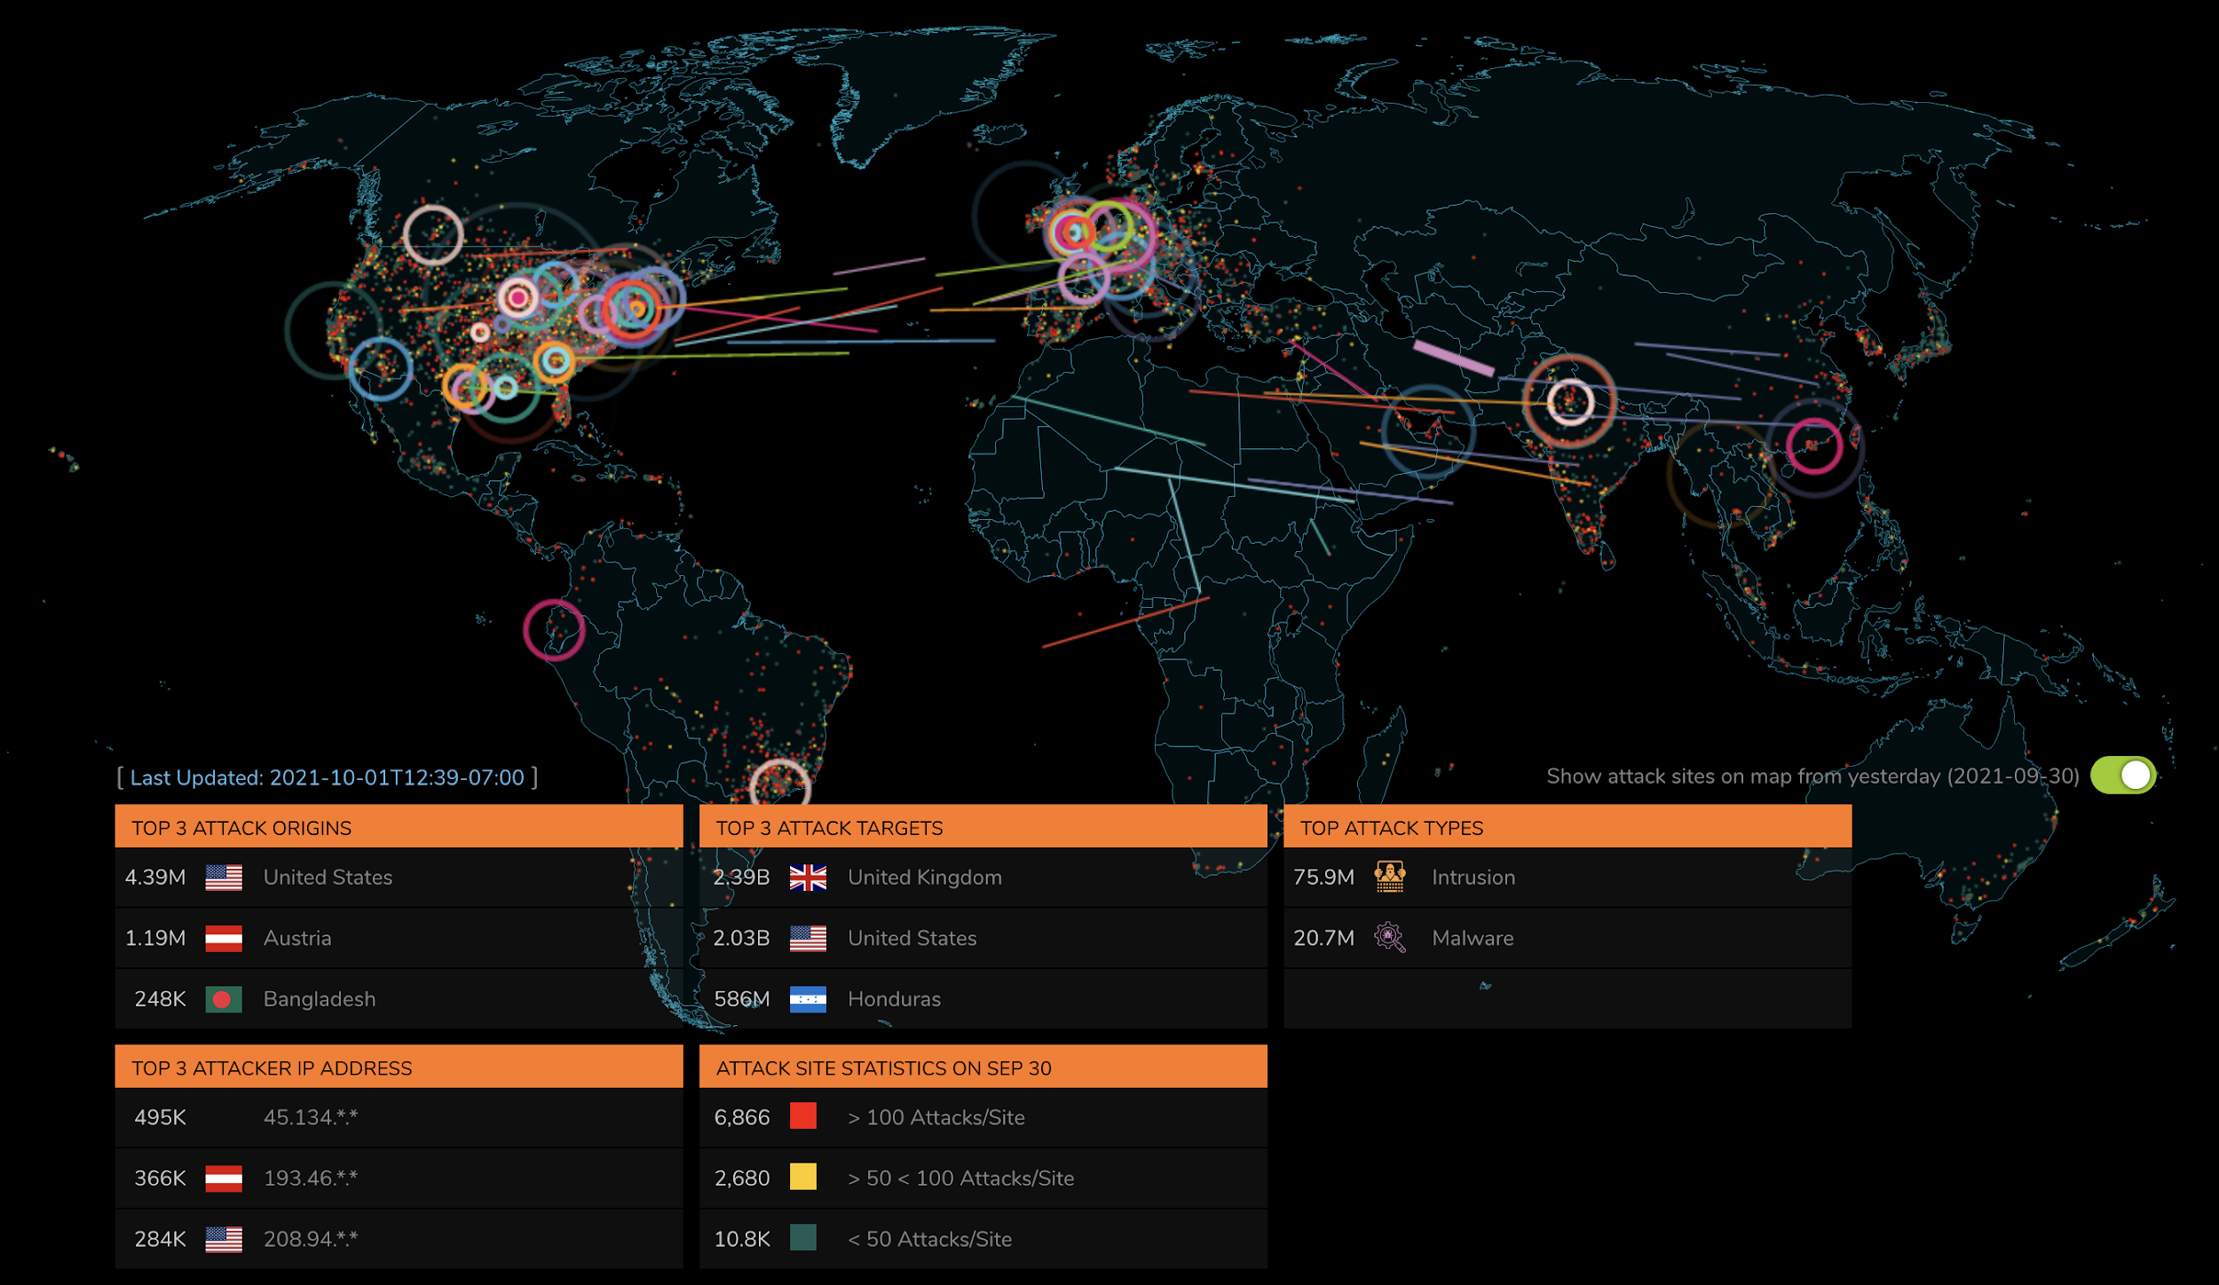
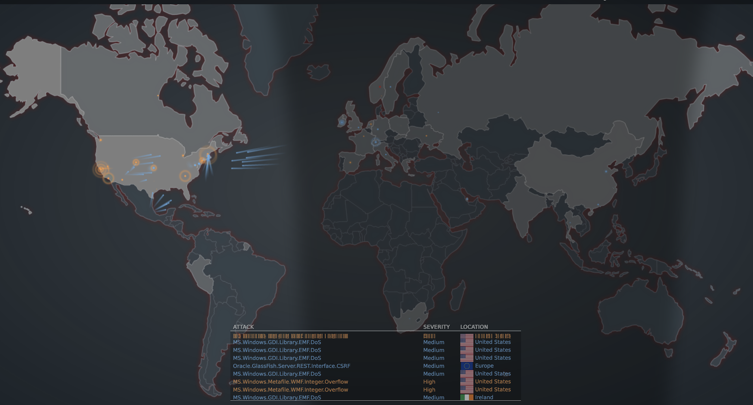
The Threat Lanscape
https://attackmap.sonicwall.com/live-attack-map/
https://threatmap.fortiguard.com/
Notes:
Everyday cybersecurity attacks are occurring throughout the world over the Internet.
These two images that you see are screenshots of cyber attacks taken from the Sonicwall and Fortinet websites.
These two sites provide real-time attacks globally in a visual and graphical perspectives.
Let’s take a look at each attack map now by clicking on the images...

Slide 7
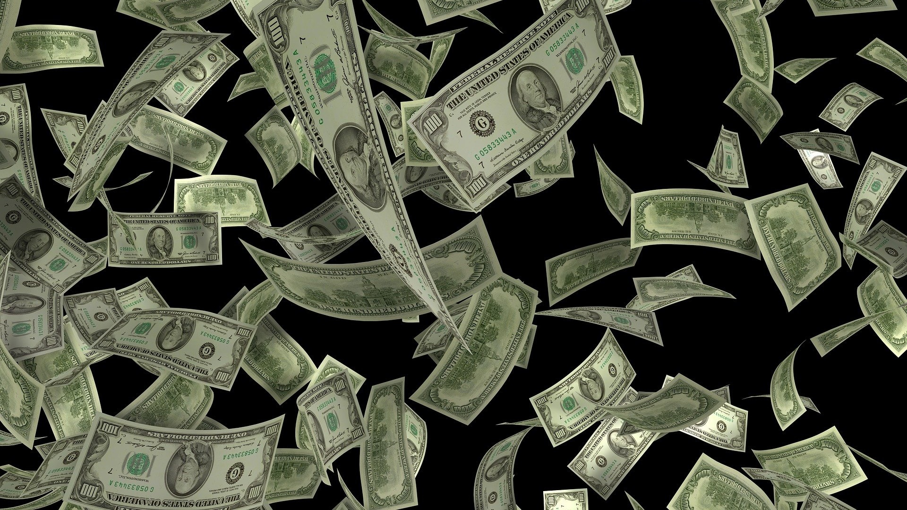
THE COST OF CYBERSECURITY
$500m
$1t
2022- 1 bank spent over
$500 million to fight cyber crime
(FORTUNE)
2017-2023 - An estimated $1 trillion was spent on cybersecurity (CYBERSECURITY VENTURES)
$22b
$217
2024 - Government will spend a projected $22 billion on cybersecurity
(WHITE HOUSE)
estimated cost per record per data breach in the US
(FORBES)
JOB GROWTH
‹#›
Notes:
Dissimilar to other organizational operations such as marketing and sales, cybersecurity can be a very expensive endeavor.
For example, an undisclosed bank spent more than $500 million dollars in 2015 to fight its ongoing cyber crime.
Another example was the US government which spent in 2017 an amount of $19 billion on their activities to defend against cybersecurity attacks.
From the past four years, an estimated one trillion dollars was spent on cybersecurity according to cybersecurity ventures.
And lastly, an estimated $217 dollars was the estimated cost per record per data breach in the US, according to Forbes magazine.
Even these are just estimates, the cost to defend and protect against cybersecurity is continuing to grow along with the need to employ more cybersecurity workers which means the continuation of job growth in this job sector.

Slide 8
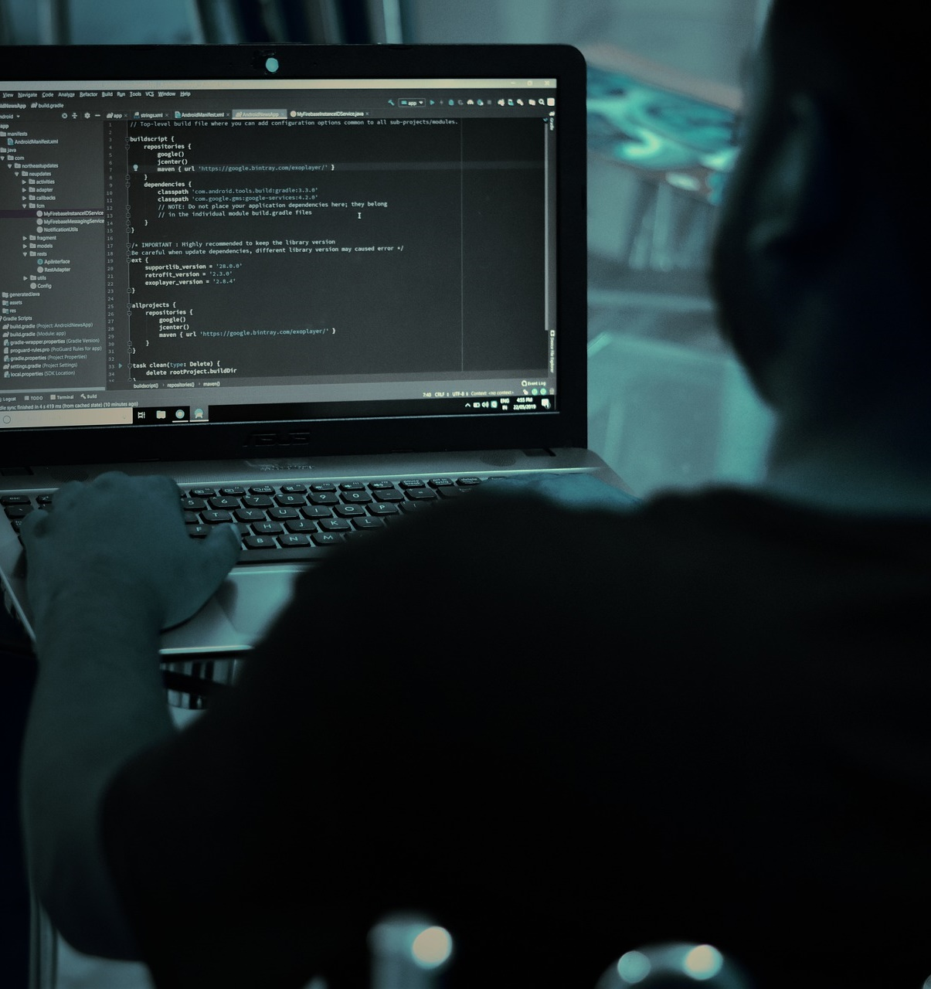
?
WHAT ARE HACKERS?
GOOD OR BAD
A person who is skilled in technology that works to overcome obstacles and to gain access into a system.
‹#›
Notes:
Now, let’s discuss hackers, there are both good and bad hackers and others in between.
In defining a hacker, a hacker is a person who is skilled in technology, whether it be wireless or wired, that works
to overcome obstacles such as a firewall or bastion host, to gain access into a system.
Just as a side note before we discuss examples, originally the term for a hacker was called something else, a
cracker.
A cracker was a person who “cracked” systems for their own malicious use while a hacker was someone who hacked a system for helping by “hacking” a system not cracking.
However, the media mistakenly grabbed onto the term hacker instead of cracker and made the term hacker the
evil actor per se, while ditching the term cracker all together from our vocabulary.
Thus, today the term hacker has stuck to represent both good or bad, while cracker is rarely referenced anymore.

Slide 9
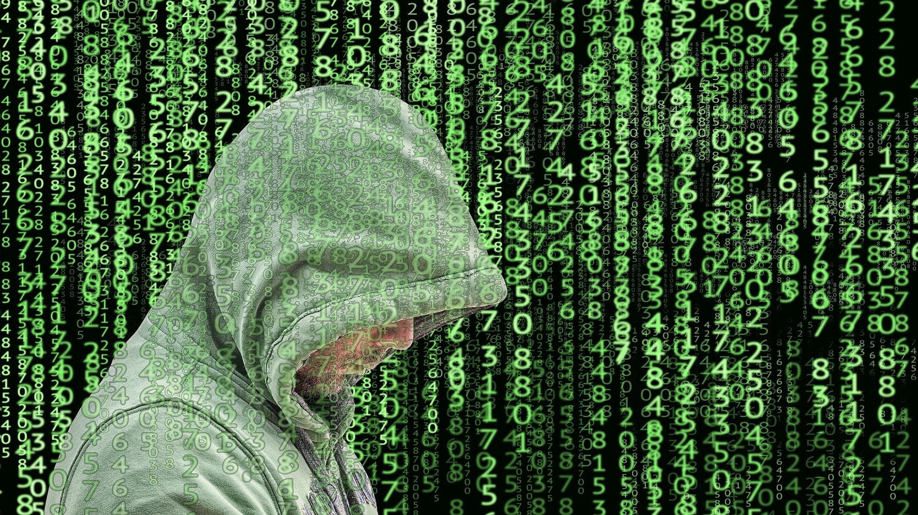
THE THREE HATS OF HACKERS
BLACK
HAT HACKER
BAD
WHITE
HAT HACKER
GOOD
GREY
HAT HACKER
BOTH
‹#›
Notes:
Let’s look at the different categories of hackers.
First, there’s a black hat hacker who is an actor with malicious intentions such as breaking into a network,
downloading customer personal data, and possibly reselling this data on the dark web.
On the other side of the hacking universe is the white hat hacker.
Similar to cowboys who wear white hats, white hat hackers behave with good intentions such as helping out with
network issues or providing workarounds for preventing unauthorized intrusions by pen testing a network.
The third type of hacker are the grey hat hackers who “toe the line” per se between good hacking and bad
hacking.
For example, grey hat hackers may provide support to an organization by attempting to sniff out black hat hackers
out of a network by using a packet sniffing program such as wireshark to sniff out any malicious activities while at the same time monitoring the network traffic for learning about any company secrets for their own private
benefit.
Another type of action by grey hat hackers is to discover a vulnerability by exploitation and then advertise on
the Internet that a vulnerability exists.
From this type of example, a grey hat hacker may stand to receive positive and/or negative recognition for
discovering the vulnerability.

Slide 10
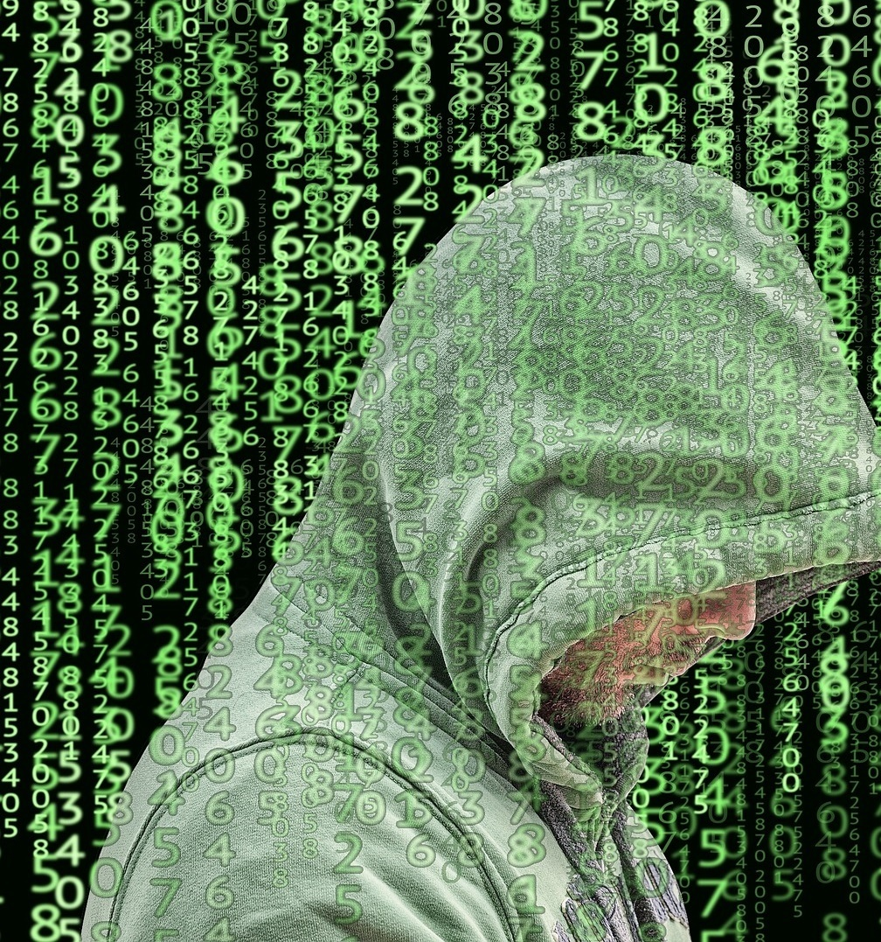
BLACK
BLACK HAT HACKER
Very Skilled with technology
Someone who tries to access a system with criminal intent and without proper authorization
They do not always have to access a system but can also place a “bug” that gives harmful intent
‹#›
Notes:
To breakdown the common characteristics of a black hat hacker,
they tend to be very skilled with all types of technology.
They typically try to access a system with criminal intent,
specifically without proper authorization.
And thirdly, they find a way to access a system when they don’t have proper access by
injecting or placing a software bug that is malicious or harmful with intent to compromise a system.

Slide 11
WHITE
WHITE HAT HACKER
Someone who has permission to access a system using methods a black hat hacker might try in order to look for vulnerabilities
Hired to do so or it is their job to hack for beneficial reasons
‹#›
Notes:
Revisiting the white hat hacker, this type of hacker has permission to access
a system using methods by a black hat hacker in order to find system vulnerabilities.
Also, a white hat hacker may be hired by an organization to hack the organization’s
system to find potential or even current vulnerabilities for benefiting the organization to
close and patch before real hackers attempt to hack the organization.

Slide 12
GREY
GREY HAT HACKER
A mix between both Black and White hat hackers
Is not given permission or authorization but will still hack and advise a company of its vulnerabilities. Expecting fee or money to help fix the vulnerability.
‹#›
Notes:
The grey hat hacker is a mix or hybrid between a black hat and white hat hacker.
This type of hacker is not given permission or authorization but will still hack
and advise a company of its possible vulnerabilities if any exist.
The grey hat hacker will also expect a fee, like a bounty, in the form of money or recognition to help
fix holes and vulnerabilities in a system within an organization.

Slide 13
WHY IS INFRASTRUCTURE IMPORTANT?
The essential services that our country depend on. These are the backbone and what America depends on to function.
These are highly sensitive as they receive the most types of cybersecurity threats or attacks.
CIP or Critical Infrastructure Protection - the need and priority to protect the most important items to run a country.
Government is heavily involved in protecting these 16 sectors. WHAT ARE SOME????
Notes:
Answering the all important question, “Why is infrastructure important?”:
First, as a country, we depend and rely upon essential services because these essential services are the backbone of the US.
Imagine not having clean water, or purchasing inedible food from the grocery store, or even worse not having Internet access!
Unfortunately, because these essential services are important to all of us, these same services are higher on the radar for hackers and their cyber attacks.
An acronym for describing the need and priority to protect essential services is referred to as CIP or Critical Infrastructure Protection.
And because these services are essential to all Americans, the US Government is a lead protector of all 16 sectors.
Let’s now take a look at these essential services along with examples.

Slide 14
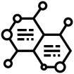














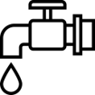
16 MAJOR CRITICAL INFRASTRUCTURE SECTORS
CHEMICAL
COMMERCIAL FACILITIES
COMMUNICATIONS
CRITICAL MANUFACTURING
DAMS
DEFENSE INDUSTRIAL BASE
EMERGENCY SERVICES
ENERGY
FINANCIAL SERVICES
FOOD AND AGRICULTURE
GOVERNMENT FACILITIES
HEALTH CARE AND PUBLIC HEALTH
INFORMATION TECHNOLOGY
NUCLEAR REACTORS, MATERIALS AND WASTE
TRANSPORTATION SYSTEMS
WATER AND WASTEWATER SYSTEMS
Notes:
As you can see, there are 16 major critical infrastructure sectors within the US.
If you’re not already familiar with the term infrastructure, infrastructure simply means basic physical facilities such as buildings, roads, and power supplies, etc.
In other words, infrastructure represent the things that keep us functioning with the Internet, travelling between locations, and supply of food to name just a couple.
The US infrastructure is very important to our daily lives, let’s see why.

Slide 15

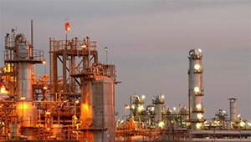
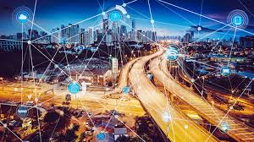



CHEMICAL
Nuclear power plants, energy resources
COMMERCIAL FACILITIES
Places of business with large gatherings such as malls
COMMUNICATIONS
Satellite and wireless communications
‹#›
Notes:
The chemical sector is mostly composed of nuclear power plants, for instance, the palo verde nuclear plant in Arizona for example, along with other energy resources that offer electrical services.
Commercial facilities are comprised of places of business such as indoor arenas, malls, and outdoor stadiums, etc.
The communications sector is made up of satellites launched by private organizations such as SpaceX, wireless
communications, such as Verizon and AT&T.
Reference:
https://www.aps.com/paloverde

Slide 16
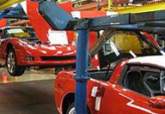
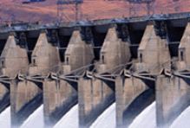




CRITICAL MANUFACTURING
Producing products in bulk such as companies that make cars
DAMS
Helps contain and control large bodies of water
DEFENSE
INDUSTRIAL BASE
Research and development, as well as design, production, delivery, and maintenance of military weapons systems
‹#›
Notes:
For the critical manufacturing sector, car makers such as Tesla, Chevy, and Ford are found categorized as critical
manufacturing because of the manufacturing in bulk from the use of assembly lines made famous by the late, great
Henry Ford.
Another important service is the containing and controlling of large bodies of water by man-made dams.
For example, the Hoover dam is located near Las Vegas and is owned and operated by the US government.
Defense industrial bases are also essential due to their use of R&D purposes and the development of military
weapons systems.
Two examples would be Lockheed Martin and Raytheon Technologies.

Slide 17


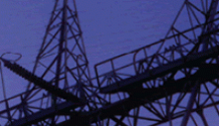



EMERGENCY SERVICES
Police departments and fire stations, county sheriff’s offices, Department of Defense police and fire departments, and town public works departments
ENERGY
Oil, Electricity, Natural Gas - supplying fuels to the transportation industry, electricity to house and businesses, and other sources of energy that are important to growth and production across the nation
FINANCIAL SERVICES
Banks, Credit Card Companies, Insurance companies
‹#›
Notes:
The next service covers emergency services which are also critical to all cities across the US.
Police, fire, coast guard, and the department of defense are crucial for providing support to citizens and their ways of life everyday.
All of these emergency services are reliant upon the next sector, energy, in the form of oil, electricity, gas, etc.
Providing the ability to function within offices and travel from location to location, the energy sector is another important sector to power the nation on a daily basis.
Finance is also important not only for individuals, but also for organizations.
Protecting against attacks against banks, credit card companies and insurance companies is a must for stabilizing
the nation’s economy.
Visa and Mastercard are examples of financial services.

Slide 18






FOOD AND
AGRICULTURAL
2.1 million farms, 935,000 restaurants, and more than 200,000 registered food manufacturing, processing, and storage facilities
GOVERNMENT
FACILITIES
Educational buildings, museums, national monuments and several buildings owned by the local state and
federal government.
HEALTHCARE AND PUBLIC HEALTH
Protects all sectors of the economy from hazards such as terrorism, infectious disease outbreaks, and natural disasters
‹#›
Notes:
Food is essential to not only humans, but also animals as livestock and even our pets.
It’s difficult to imagine not having access to food these days.
Therefore, it should be no surprise that food and agricultural is an essential sector to defend against hackers.
There are over 2.1 million farms, 935,000 restaurants and 200,000+ food manufacturers and storage facilities.
In addition to food and agricultural, government facilities are also considered essential public services.
Everything from schools, museums to national monuments are also important within the government.
They provide services to the public and continue to operate for helping people learn and socialize.
I think everyone can relate to the healthcare and public health sector since we all experienced the current pandemic for the
past 2 years.
Public healthcare is a vital sector to protect in order to provide healthcare when outbreaks occur and natural
disasters happen.

Slide 19
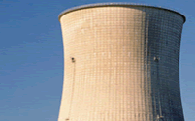



INFORMATION
TECHNOLOGY
Software and services, technology hardware and equipment and semiconductors and semiconductor equipment
NUCLEAR REACTORS, MATERIALS, AND WASTE
Covers most aspects of America’s civilian nuclear infrastructure
‹#›
Notes:
Two other important sectors are the information technology sector and the nuclear reactors, materials, and waste
sectors.
As mentioned before, both these sectors are critical for software development, Internet services, as well as the
semiconductor equipment such as new computer chips.
And again as mentioned previously, the defense of our nation’s nuclear reactors is mission critical for providing
electrical services to millions of people across the US.

Slide 20




TRANSPORTATION SYSTEM
Quickly, safely, and securely moves people and goods through the country and overseas - Highways, Boats, Airplanes, Trains
WATER AND WASTE
Ensuring the supply of safe drinking water and waste treatment and service is essential to modern life and the Nation’s economy
‹#›
Notes:
The last two sectors cover our transportation system and the disposal of waste while providing drinkable water.
The transportation system is vital to our way of life for driving our cars, riding buses and trains, flying in planes, and
on waterways in boats.
Imagine not being able to quickly get an Uber to ride to your favorite fast food restaurant or the inability to take the
subway in a metropolitan city?
Last but not least, waste management is important for the removal of garbage from communities and cities.
Just as important, humans must have clean, safe drinking water to survive.
Therefore, water and waste are just as crucial and important as the other 15 sectors.
Let’s now turn to examples of cyber threats to critical infrastructure.

Slide 21
EXAMPLES OF CYBER THREATS TO CRITICAL INFRASTRUCTURE
HUMAN DEFICIENCIES
Insider Threats
Social Engineering
Phishing Attacks
Election Hacking
SYSTEM DEFICIENCIES
Legacy Software
Default Configurations
Encryption
Unsegmented Networks
Denial of Service (DDoS)
Malware
Ransomware
Parameter Manipulation
Notes:
Two types of cybersecurity deficiencies are human deficiencies and system deficiencies.
Under human deficiencies, some of these are well known.
An insider threat may be someone commiting an inside job within an organization or espionage by selling info to another country.
Social engineering is a method for tricking a human out of control to access private information.
Phishing attack is an attack via email, for instance, by including malicious links or buttons to click on for collecting personal info.
Election hacking is the attempt to create, delete, or modify votes registered in a voting machine.
For system deficiencies, a legacy system is an old, outdated system lacking the latest system updates.
Default configurations are the original settings left configured in a system that should be hardened and secured.
Encryption is the lack of encrypting data leaving data in plain text.
Unsegmented networks are internal machines that should be separated from public machines in a DMZ or demilitarized area of a network.
Denial of Service or DDoS is an attack on a web service or website to over request and inundate its resources for taking over.
Malware is software that has malicious code embedded in a program or script.
Ransomware is the encrypting of organizational data by hackers in order to receive a ransom of money to release the data back to the organization.
And parameter manipulation is the changing of parameters in a URL for a web page for gaining access to a website or web application.

Slide 22
Protected Critical Infrastructure Information (PCII) Program
Critical Infrastructure Information (CII) Act of 2002
Protect private sector infrastructure information
Voluntarily share information with the government
Protection under Homeland Security
Notes:
On November 25, 2002, the Critical Infrastructure Information Act of 2002 (CII Act) was created to seek to facilitate greater sharing of critical infrastructure information among the owners and operators of the critical
infrastructures and government entities with infrastructure protection responsibilities, thereby reducing the nation’s vulnerability to terrorism.
This act helps combat cybersecurity nationally by simply sharing information among critical infrastructures and government for protecting the private sector.
It’s voluntary to share and protected under homeland security.
Reference: https://www.cisa.gov/publication/cii-act-2002
https://www.cisa.gov/sites/default/files/publications/CII-Act.pdf

Slide 23
Cybersecurity Framework
Cybersecurity Enhancement Act of 2014
Private-sector and government experts created the Framework
Help organizations understand their cybersecurity risks (threats, vulnerabilities and impacts)
Reduce risks with customized measures and help respond and recover from cybersecurity incidents
Companies that utilize the framework includes Microsoft, JP Morgan Chase, Boeing, Intel, etc
Notes:
Under the Executive Order of the President, the Secretary of Commerce is tasked to direct the Director of NIST, which stands for National Institute of Standards and Technology, to lead the development of a framework to reduce cyber risks to critical infrastructure.
The Framework consists of standards, methodologies, procedures and processes that align policy, business, and technological approaches to address cyber risks.
It helps organizations understand cyber risks.
It reduces risks with measures and help/respond/recover from incidents
Companies that use the framework range from Microsoft to Chase Bank to Boeing and Intel
https://csrc.nist.gov/News/2014/Cybersecurity-Framework
https://www.nist.gov/cyberframework

Slide 24
NIST CYBERSECURITY FRAMEWORK
IDENTIFY
PROTECT
DETECT
RESPOND
RECOVER
Asset Management
Business Environment
Governance
Risk Assessment
Risk Management Strategy
Access Control
Awareness and Training
Data Security
Info Protection Processes and Procedures
Maintenance
Protective Technology
Anomalies and Events
Security Continuous Monitoring
Detection Processes
Response Planning
Communications
Analysis
Mitigation
Improvements
Recovery Planning
Improvements
Communications
Notes:
The NIST Cybersecurity Framework focuses on using business drivers to guide cybersecurity activities and considering cybersecurity risks as part of the organization’s risk management processes.
The NIST Cybersecurity Framework is broken down into 5 components:
Identity
Involves Business environment and assets along with governance and risk strategies
Protect
Access, Data, Info, in addition to maintenance with protective technology
Detect
Strange events, continuous monitoring, and how to detect
Respond
How to respond, communicating, mitigating a situation and then improve for responding next time in the future
Recover
Planning recovery, communication strategy, and improvements
https://csrc.nist.gov/News/2014/Cybersecurity-Framework

Slide 25
NIST National Institute of Standards and Technology
In order to effectively protect our infrastructure, the NIST created a guideline (framework) to help everyone stay on the same page and keep the 16 sectors secure. This includes:
Align cybersecurity decisions to mission objectives;
Organize security requirements originating from legislation, regulation, policy, and industry best practices;
Communicate cybersecurity requirements with stakeholders, including partners and suppliers;
Integrate privacy and civil liberties risk management into cybersecurity activities;
Measure current state and express desired state;
Prioritize cybersecurity resources and activities; and
Analyze trade-offs between expenditure and risk.
Notes:
Highlighting some of the frameworks points:
Making sure that mission objectives of an organization are aligned with cybersecurity decisions
Organizing security requirements to best practices and current or new legislation that passes
Always communicating an organization’s cybersecurity requirements to all stakeholders and third-parties
The inclusion of privacy and civil liberties into an organization’s cybersecurity activities
Always monitoring current state and measuring for nearing a more desired state
Prioritizing resources and activities on a daily, weekly, monthly, and year-to-year
Finally, an analysis of any trade-offs between risks and expenditures for cybersecurity.

Slide 26
ISO
International Organization for Standardization
While NIST is more security control driven with a wide variety of groups to encourage best practices related to federal information systems, ISO less technical and more risk focused for organizations of all shapes and sizes.
Both NIST and ISO can be used together using the best areas to fight against unwanted intrusions but NIST is the only mandatory framework.
COBIT
Control Objectives for Information and Related Technology
Created by ISACA - Informations Systems Audit and Control Association
Ensures quality, control, and reliability of information systems in an organization, which is also the most important aspect of every modern business.
OTHER STANDARDS
Notes:
And lastly, two other standards also exist.
They are ISO which stands for International Organization of Standardization.
ISO helps support organizations with standardizing processes and procedures for all different types of organizations in the world.
COBIT stands for Control Objectives for Information and Related Technology.
It simply is a framework for ensuring quality, control, and reliability of information systems for organizations.
Both standards can be used in conjunction with the NIST framework.

Slide 27

THANK YOU
Notes:
Hopefully, all of you were able to gain a better understanding of Cybersecurity and the potential future directions this sector is moving towards.
Thank you for listening and being attentive so I’ll now turn this back over to Matt and Will for continuing onward, thank you!

